Slide 1
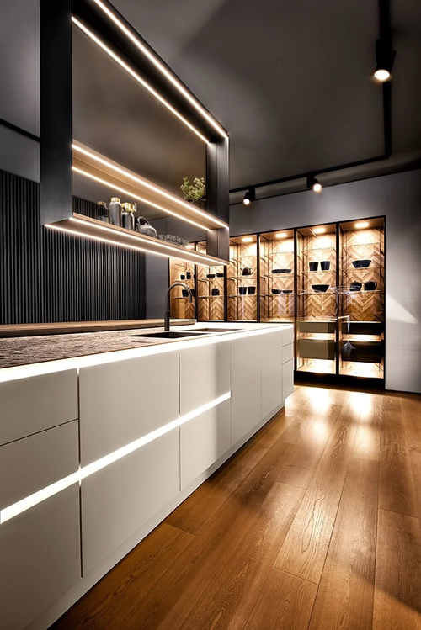
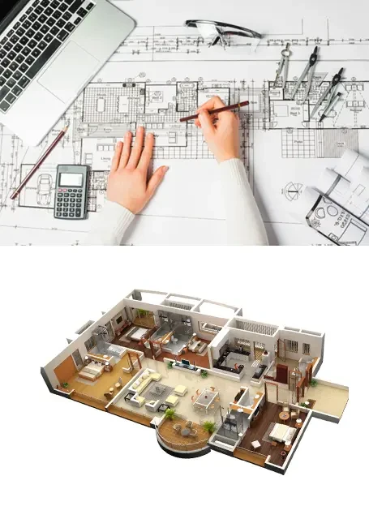
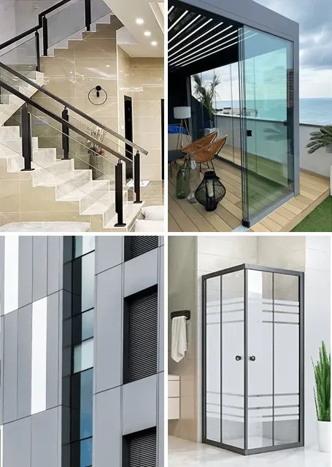
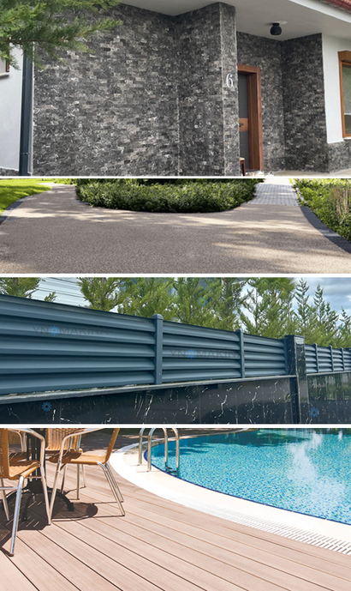
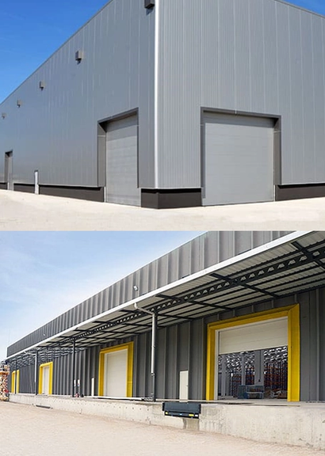
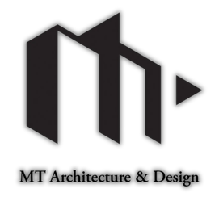

2026 JANUARY
Products Catalog
Presentation
www.iduvan.com

Slide 2
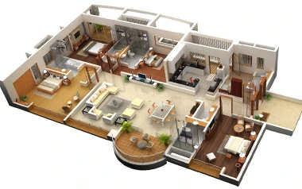

Contents
We are your solution partner for your project.
Our Brief
Our Product Groups
Interior Furniture Manufacturing
Kitchen
Bathroom
Dressing Room and Dress Cabinet
TV unit
Coatter and Cloakroom
Click here for quick access to the pages.
Inner door
Exterior door
Architecture and Interior Design
Aluminum and Glass Systems
Exterior products and systems
Deck
Metal Fence
Stone Carpet
Natural Wall Stones
Industrial Door Systems
Bed and Base Set
Contact us

Slide 3
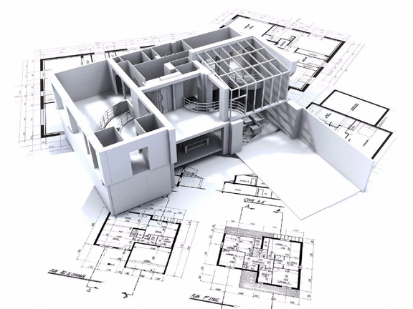
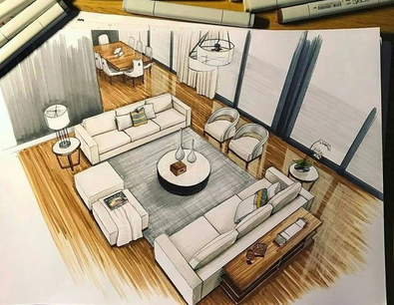
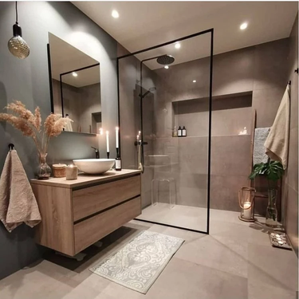
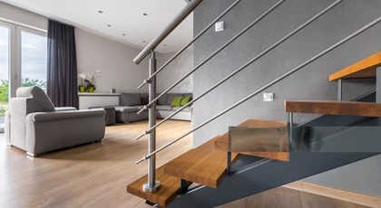
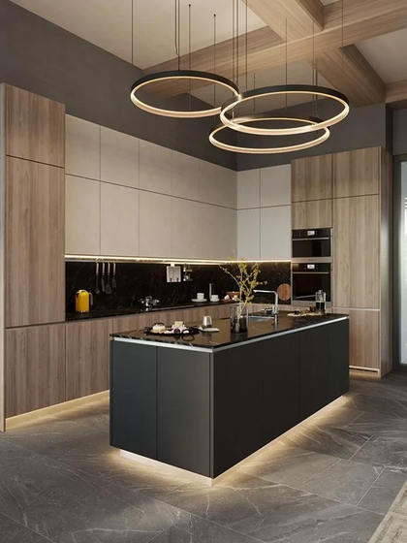
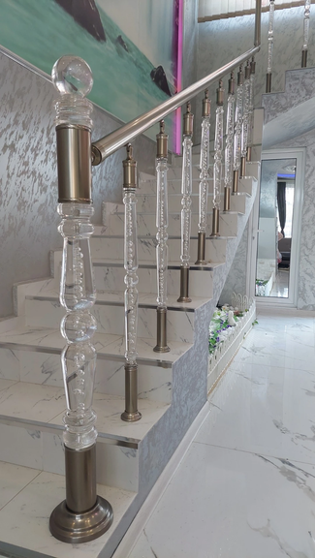
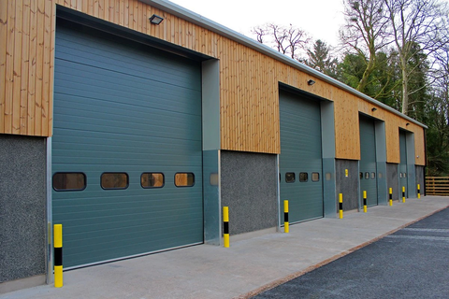
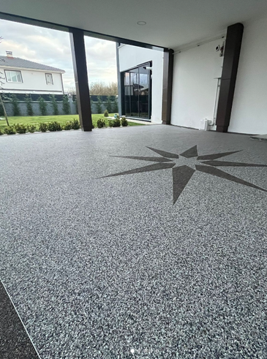
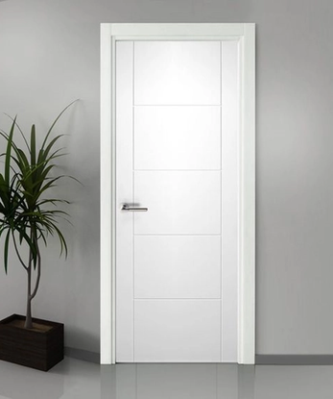
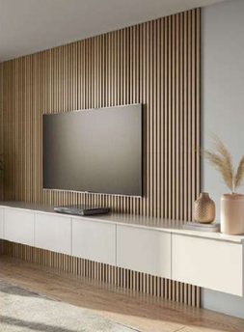
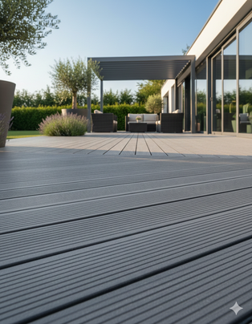
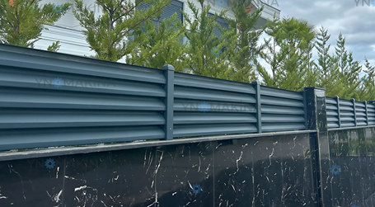
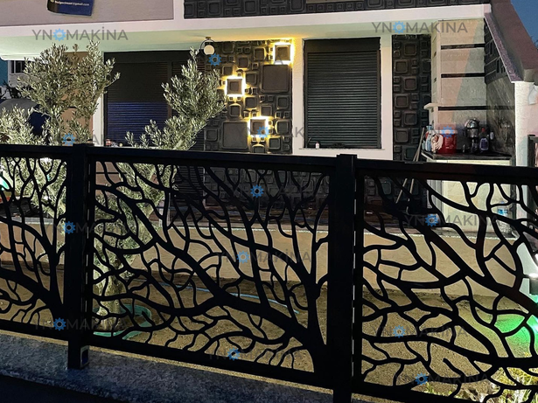
Our Brief
As iDuvan and MT Architecture and Design, we aim to supply the products your buildings need at the most competitive prices and under the most favorable conditions.
Prioritizing our reliability, we are committed to delivering the products you request under the conditions you specify, thanks to our years of experience.
In all our projects, we focus on clean lines, quality workmanship, and sustainable materials to create beautiful and practical pieces. Every design reflects our commitment to durability, comfort, and aesthetic harmony.
This summary encapsulates our vision and guides our creative process. We design and supply products for a modern, style-conscious clientele seeking products that seamlessly integrate into residential, commercial, or hotel spaces. Each piece will be consistent with your brand identity, offering a coherent and purposeful collection.

Slide 4
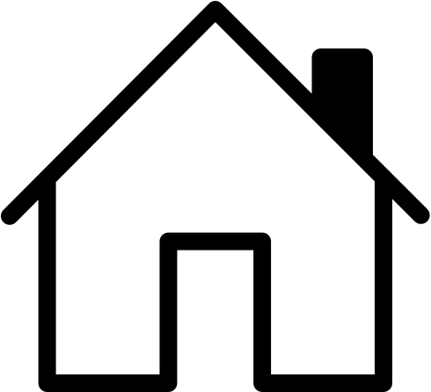
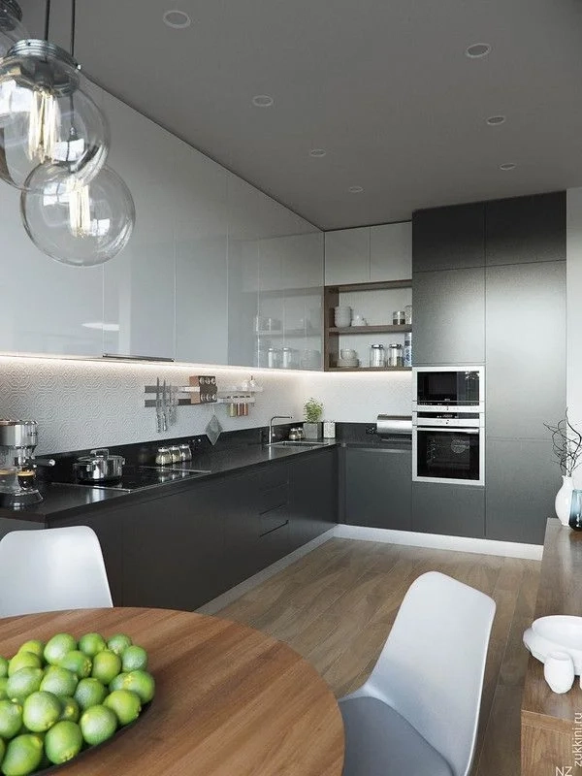
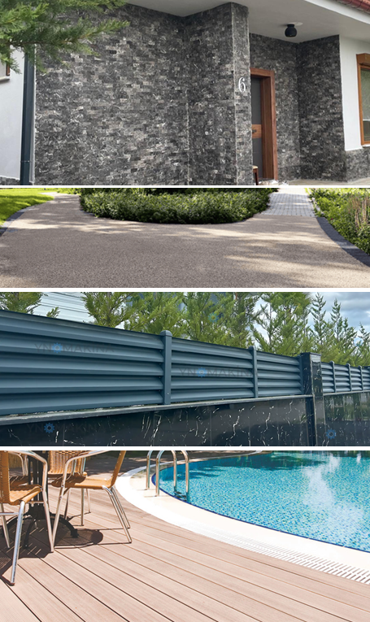

Our Product Groups
Interior Furniture Manufacturing
Architecture and Interior Design
Aluminum and Glass Systems
Exterior Products and Systems
Industrial Door Systems

Slide 5
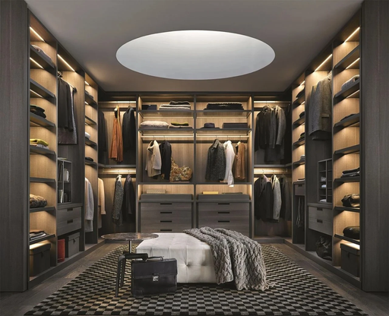
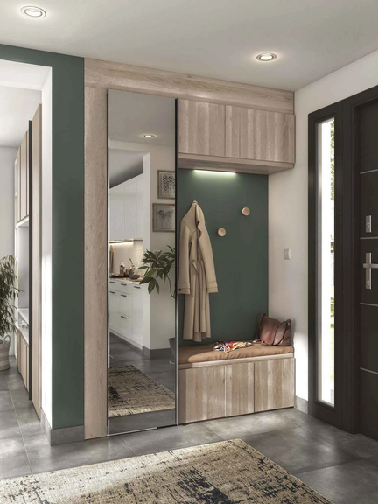
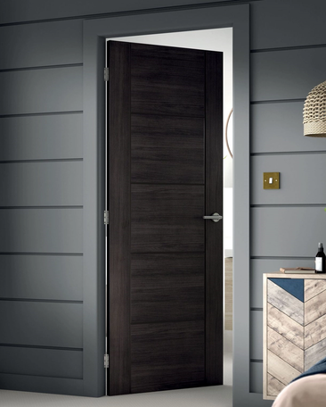
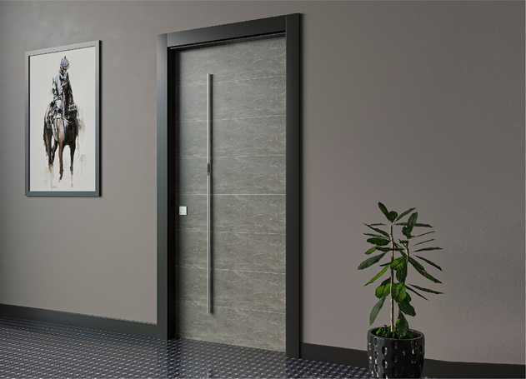
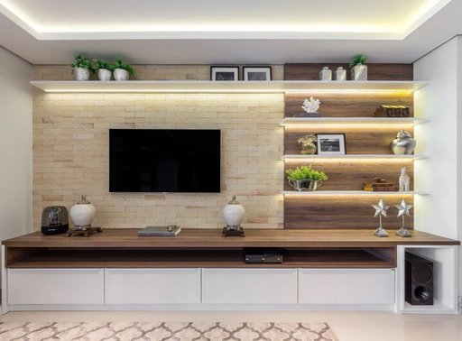
Interior Furniture Manufacturing
Click on the images to view the product gallery.

Slide 6
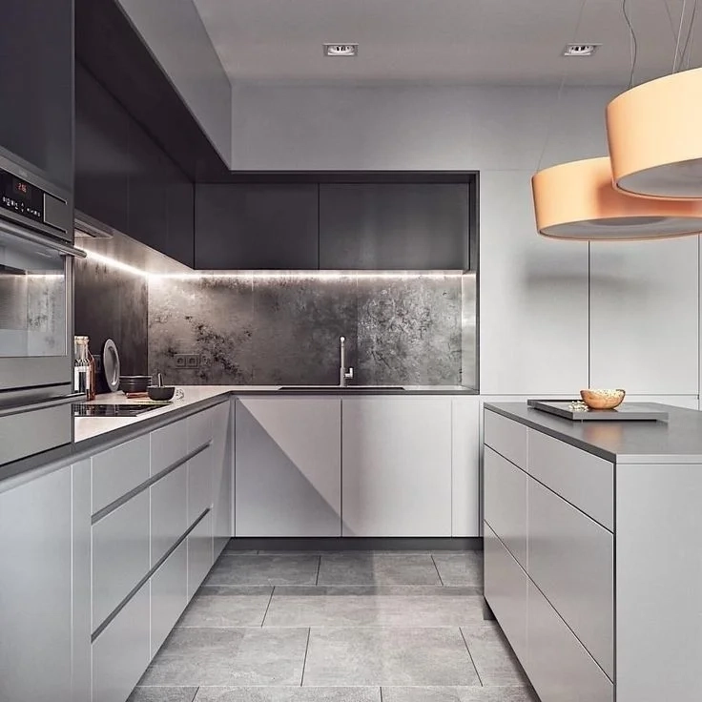
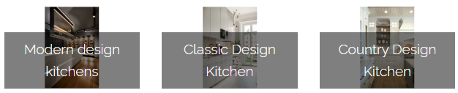
Production and Assembly
Kitchen
Kitchen decoration is one of the most careful and careful issues. Our kitchens, where we spend the majority of our daily lives, is a hidden key to our happiness that it is a place that gives peace and opens us. Whether it is large or small, unlimited colors, visual and aesthetic wealth of functional kitchens can easily use you to enjoy you. Following the world fashion, our company makes designs of special kitchen cabinets, kitchen countertops, kitchen tiles specific to your tastes.
Click on the images to view the product gallery
www.iduvan.com

Slide 7
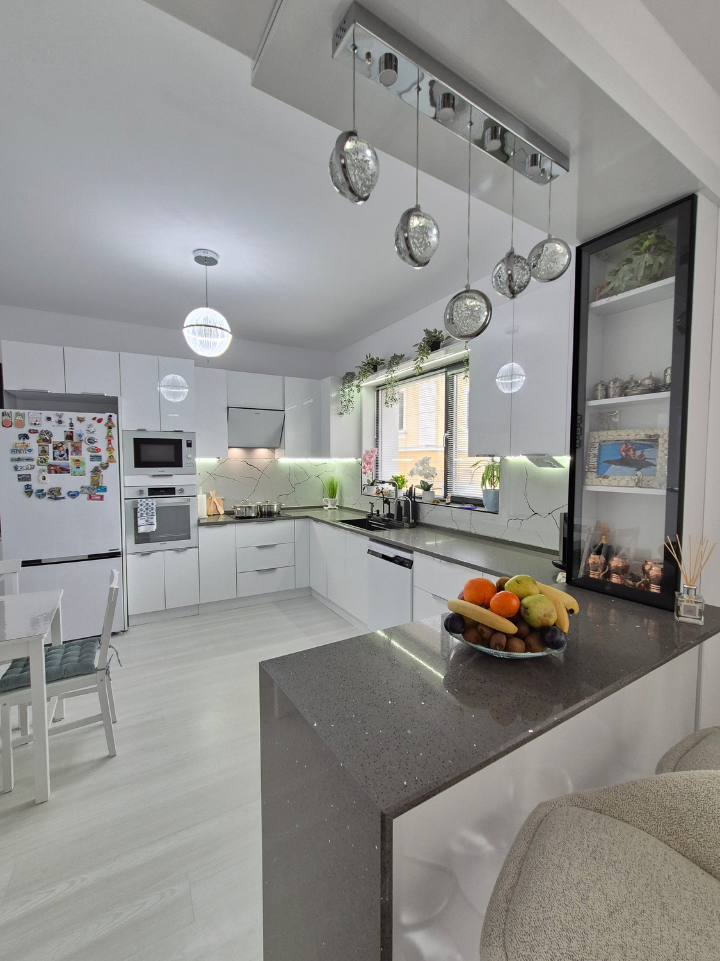
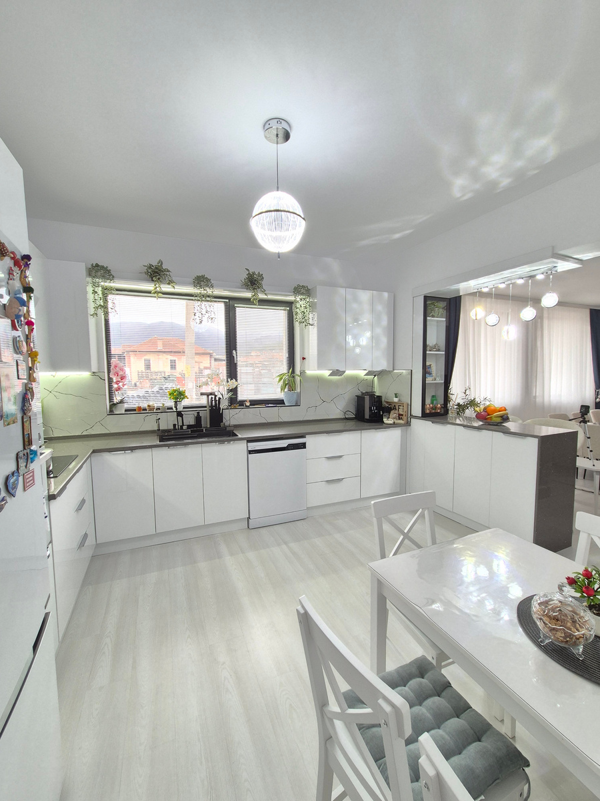
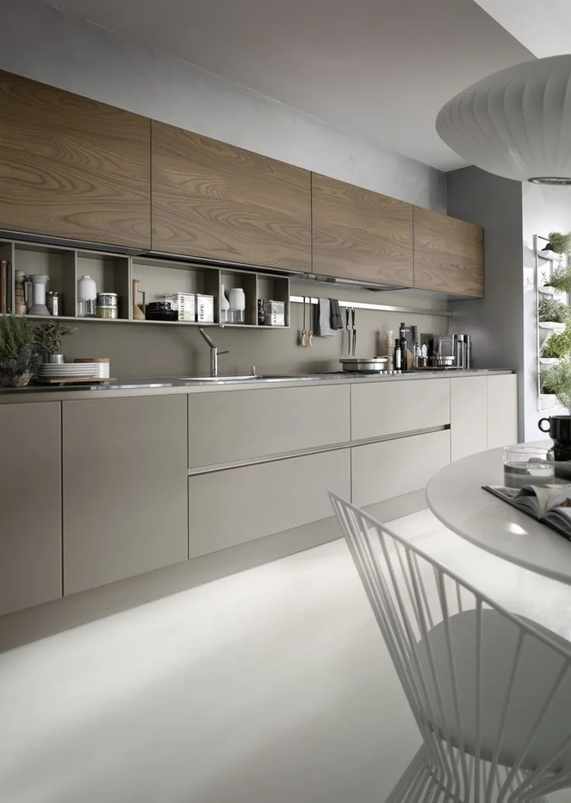
Kitchen
Production and Assembly
www.iduvan.com

Slide 8
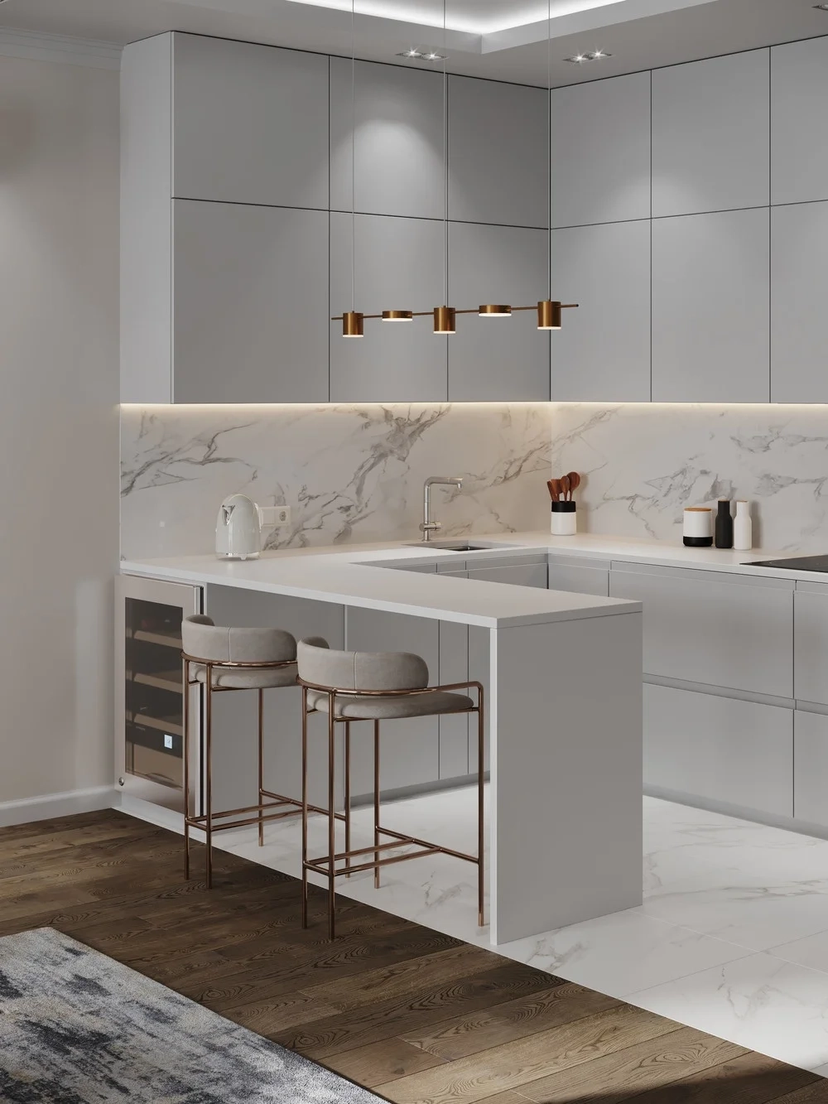
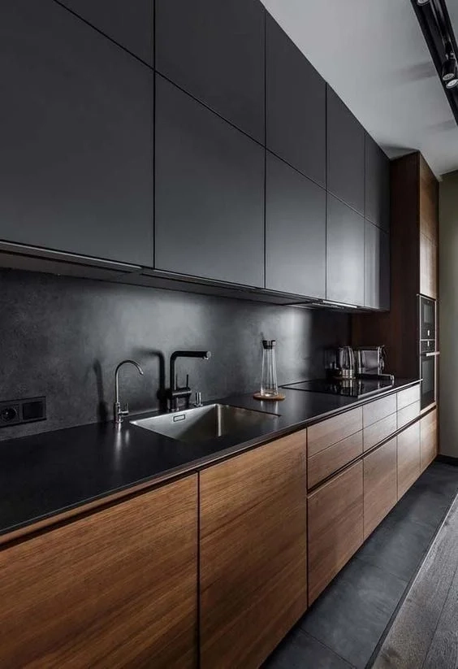

Kitchen
Production and Assembly
www.iduvan.com

Slide 9
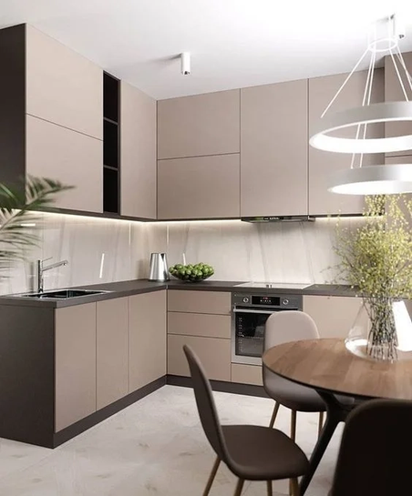
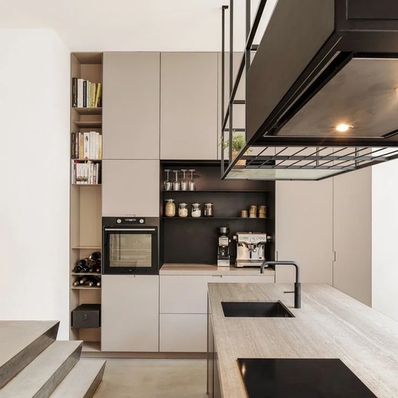
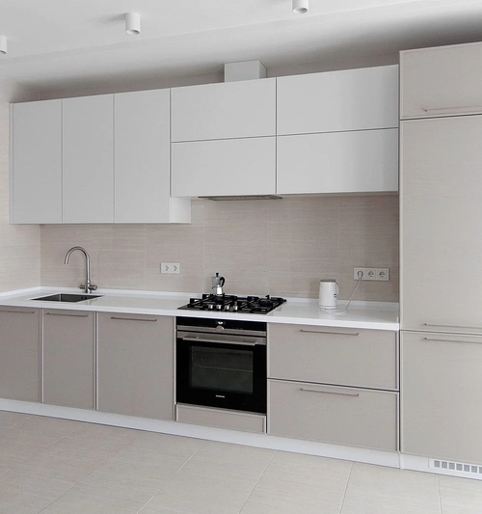
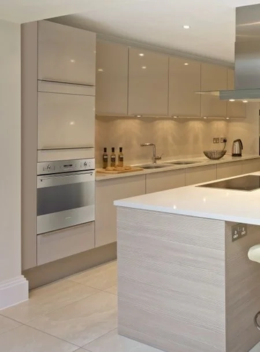
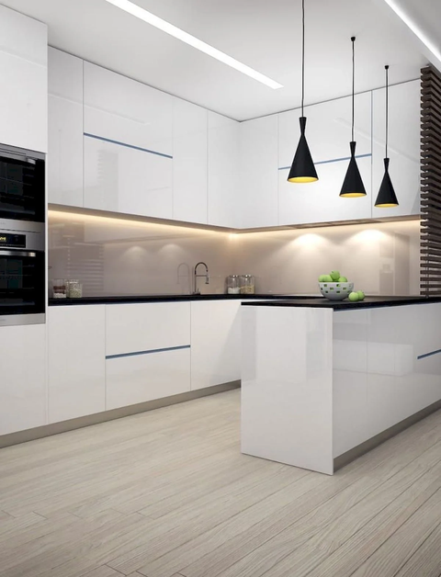
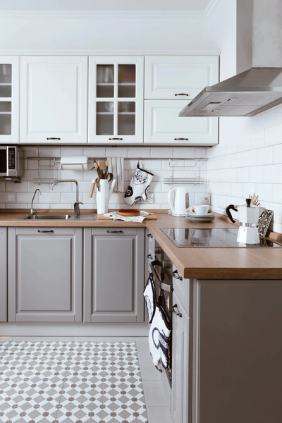
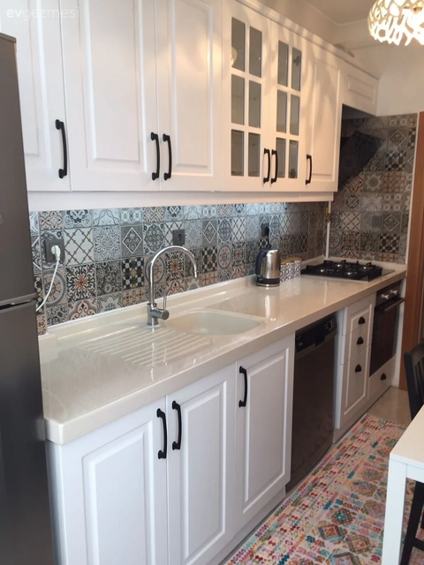
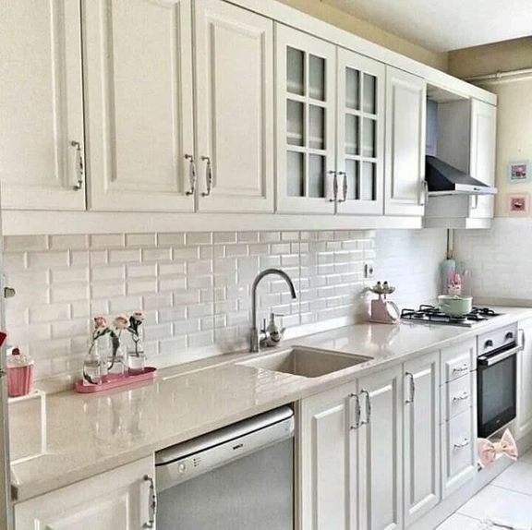
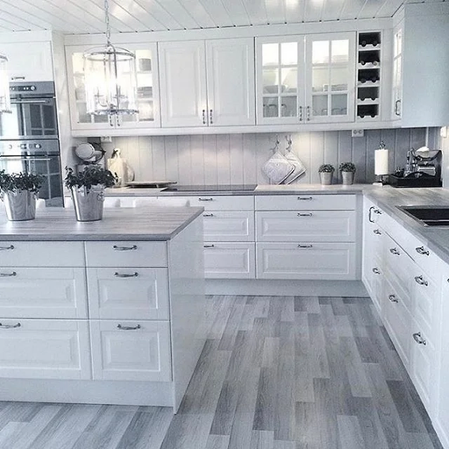
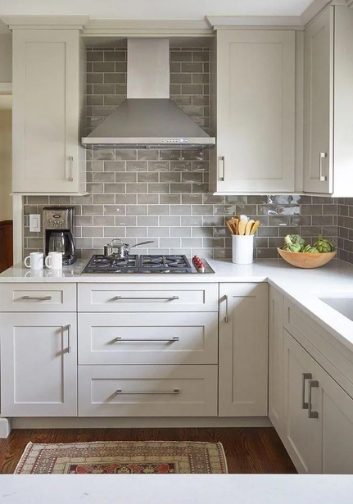
Kitchen
Production and Assembly
www.iduvan.com

Slide 10
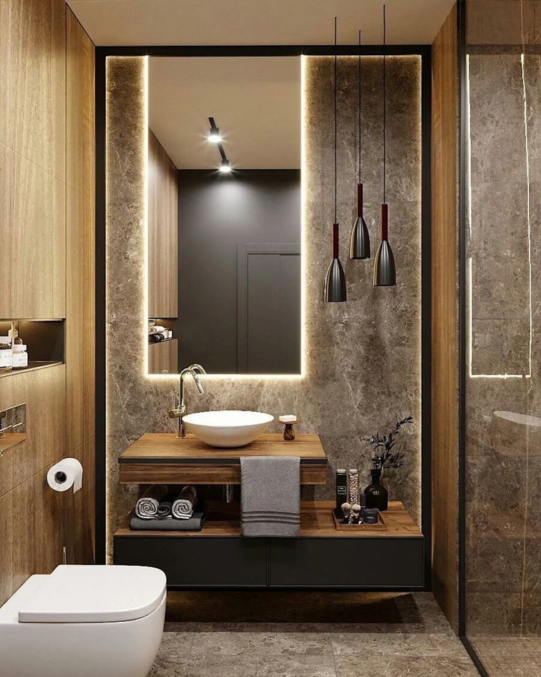
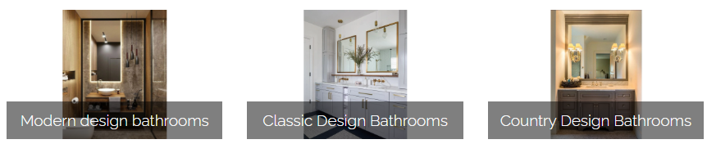
Production and Assembly
Bathroom
The bathrooms are important places where we prepare for the day when we first open our eyes in the morning and throw the intensity of the day in the evening. They are special places where we stay with ourselves, find peace and meet our cleaning needs while showering. It is important that the bathrooms, which we frequently use in daily life, are well -designed for facilitating our lives, reflecting our functional and aesthetic feelings, well -decorated.
Click on the images to view the product gallery
www.iduvan.com

Slide 11
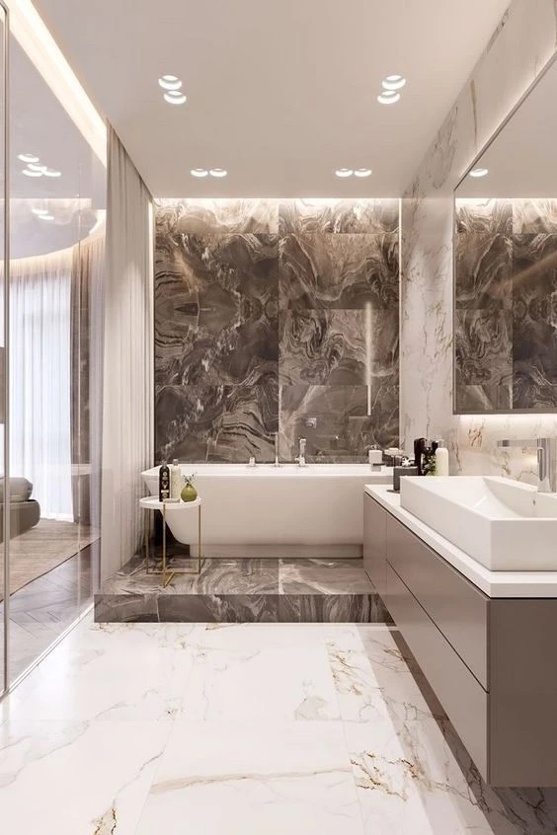
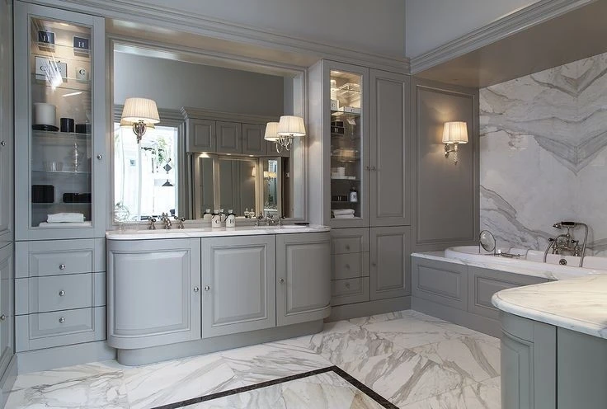
Bathroom
Production and Assembly
www.iduvan.com

Slide 12
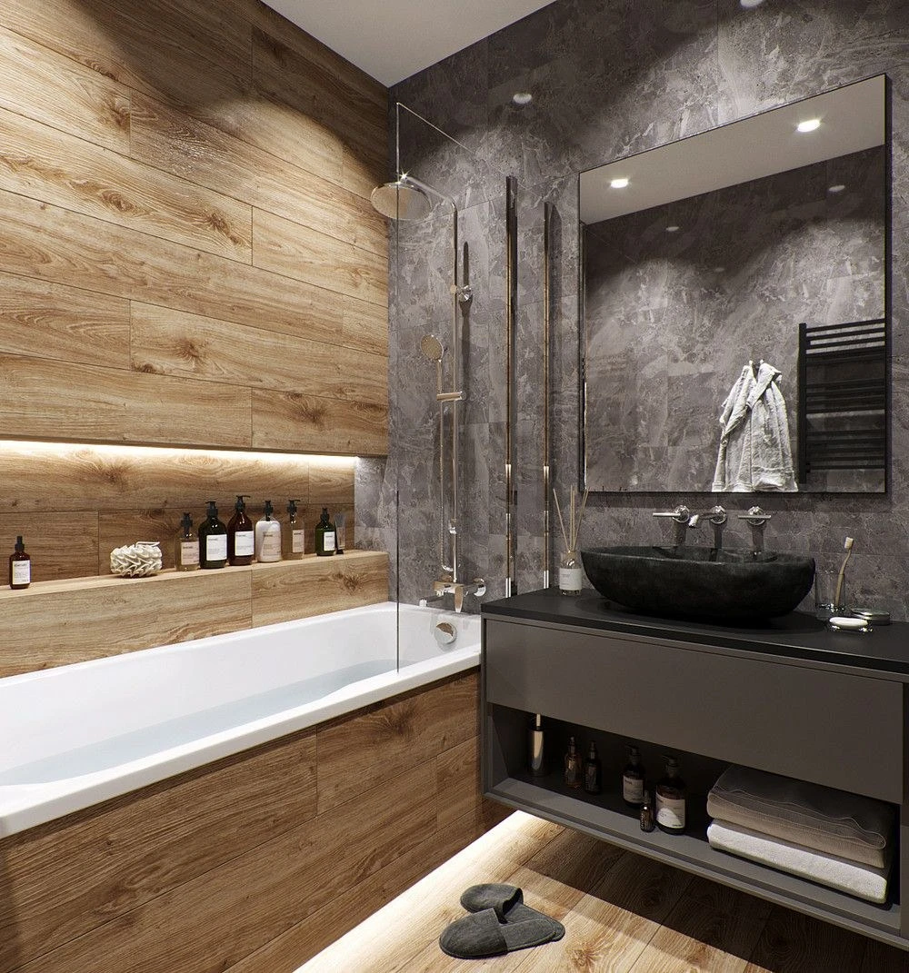

Bathroom
Production and Assembly
www.iduvan.com

Slide 13


Bathroom
Production and Assembly
www.iduvan.com

Slide 14


Production and Assembly
Dressing Room and Dress Cabinet
Even though it is always needed for storage areas, you don't want to buy a garment cabinet that won't fit in your room. You don't want to buy a garment cabinet that is not enough to meet your needs. To do this, start by taking the measurements of the area you plan to put the clothes cabinet in your bedroom.
Because of the small bedrooms of some houses, you can design and use another room as a garment room if possible. If you are going to position your clothes cabinet in the clothes room, you should take the size of your dressing room instead of a bedroom size.
You can examine the cabinet models in the furniture stores according to the dimensions you buy.
Click on the images to view the product gallery
www.iduvan.com

Slide 15




Dressing Room and Dress Cabinet
Production and Assembly
www.iduvan.com

Slide 16


Production and Assembly
TV unit
A favorite movie, you have followed a sports match you see no longer is not your television. TV units have taken its place on your walls as artworks with its designs and special lighting. Game consoles, cinema and sound systems, television and equipment covered by the area expanded.
The size of the space where your TV unit will take place is important. A large or small unit in your unit selection will not work for you as well as stylish. It is important to choose a unit according to the size of your space. If you have a big home you can choose a modular system. In the modular system, you can make additions according to the size of your television hardware.
Click on the images to view the product gallery
www.iduvan.com

Slide 17










TV unit
Production and Assembly
www.iduvan.com

Slide 18


Production and Assembly
Coatter and Cloakroom
When you come to your home, your corridor or input is time to get a cloakroom if it seems empty or boring. The clutter in your home gather and allows you to make stylish decorations.
If you care about the decoration of your home, you should carefully select all the furniture in your home. Since you are the first furniture you encounter when you enter the house, it should be stylish and also useful to suit your tastes.
Click on the images to view the product gallery
www.iduvan.com

Slide 19




Coatter and Cloakroom
Production and Assembly
www.iduvan.com

Slide 20


Sales and Assembly
Inner door
It is the products produced from materials such as wood, iron or aluminum used to transition between spaces. It is a historical material used in most cultures and nations. The door does not consist of only the wing section, there are safe and hinge sections that allow the door to work.
Used for safety and insulation. It is important to close and open a portion that should remain confidential. In addition, when the right models are preferred for sound and thermal insulation, effective results occur.
Click on the images to view the product gallery
www.iduvan.com

Slide 21









Inner door
Sales and Assembly
www.iduvan.com

Slide 22


Sales and Assembly
Exterior door
One of the most important elements for the security of our homes or workplaces is our entry points: doors. In this regard, steel doors can be an ideal choice for many who seek security, durability, and style.
Exterior doors are designed for security purposes and can be used both indoors and outdoors. They are generally made of sheet metal or metal plates, and various materials are used on the inside to increase durability and insulation.
Exterior doors stand out with their durable construction. Their resistance to burglary attempts is a reason for many people to choose them.
Click on the images to view the product gallery
www.iduvan.com

Slide 23





Exterior door
Sales and Assembly
www.iduvan.com

Slide 24




Architecture and Interior Design

Slide 25


Architecture
In order to demonstrate the project in the most ideal, functional and applicable manner of the project before being revealed, the drawing operations must be completed in accordance with a quality, correct and one -to -one reality. It is also important to meet the requests such as rationality and comfort, low cost and fast completion time of solutions to be followed throughout the process such as the creation of a design of authenticity that expresses aesthetic quality level and style for space users.
In addition to providing the drawing service of the projects of the buildings where you will realize the construction, it provides control service of your drawn projects.
www.iduvan.com

Slide 26

Interior Design
The interior design should be done after a long planning and research process. Just as the foundation of a building is laid incorrectly and erected incorrectly, attention should be paid to the interior design. A false depiction of space will bring a false formation from top to bottom. You should make the concept selection very correctly. When you forward the concept you want to your interior designer, it will give you a good interior designer advice. As a decoration advice, the concept varies according to the environment you choose.
We provide design and application services of the different and renovations you want to do in your home or home where you live.
www.iduvan.com

Slide 27







Sales and Assembly
Aluminum and Glass Systems
Click on the images to view the product gallery

Slide 28










Aluminum and Glass Systems
Sales and Assembly
www.iduvan.com

Slide 29







Aluminum and Glass Systems
Sales and Assembly
www.iduvan.com

Slide 30











Aluminum and Glass Systems
Sales and Assembly
www.iduvan.com

Slide 31









Exterior products and systems

Slide 32


Sales and Assembly
Deck
COMPOSITE DECK IS A DURABLE, COST-EFFECTIVE, AND SAFE INDOOR AND OUTDOOR FLOORING SOLUTION.
Deck materials are an environmentally friendly composite made from recycled plastic and rice husk (paddy), an agricultural waste product renewed annually. No substances harmful to human health or nature are used in the production process.
In accordance with the quality policy, Deck products are manufactured in compliance with national and international testing norms.
Their durability and environmental resistance have been tested and approved by independent laboratories. Combining aesthetics and functionality,
Deck products are a sustainable and reliable material.
Click on the images to view the product gallery
www.iduvan.com

Slide 33

Sales and Assembly
Metal Fence
Metal fence panels offer high durability and security while being long-lasting. They come in many colors and designs and can have a decorative appearance.
In our metal fence category, you can find various panel fence models that are the ideal solution for ensuring your security and privacy. Panel fences stand out for both their durability and ease of use.
Click on the images to view the product gallery
www.iduvan.com

Slide 34

Sales
Stone Carpet
Stone carpet is a type of flooring made by mixing specially prepared and sized stones with a binding resin and pouring it in place. Suitable for both indoor and outdoor use, stone carpet is long-lasting, durable, and offers a natural look. It has become a frequently chosen flooring option in recent years.
Click on the images to view the product gallery
www.iduvan.com

Slide 35


Sales
Natural Wall Stones
Wall cladding is an additional coating applied to the existing interior and exterior walls of a building. Adding cladding to walls significantly enhances the aesthetics of a structure. Hundreds of colors, patterns, and textures are available in cladding types that perfectly match the aesthetics of a building. Any type of wall cladding can transform an ordinary wall into a vibrant masterpiece.
Click on the images to view the product gallery
www.iduvan.com

Slide 36




Industrial Door Systems
Click on the images to view the product gallery

Slide 37


Sales
Industrial Door Systems
Industrial Door Warehouse, Factory, Military Facilities and large -volume facilities such as large openings in the environment in which it is the general name of automatic door systems used to close high performance areas. The industrial gate, also known as a sectional gate, is specially produced in a way that is most suitable for the size and architectural structure of the project.
Click on the images to view the product gallery
www.iduvan.com

Slide 38


Bed and Base Set
Sales
www.iduvan.com

Slide 39

Bed and Base Set
Sales
www.iduvan.com

Slide 40

Contact us
Find the perfect part to complete your projects with our wide range of products. Let us help you source your products at the most competitive prices and under the best conditions.
address 1
address 2
city of Plovdiv, Pazardzhik highway 11th km
Bulgaria
city of Edirne,
1. Murat neighborhood
6-3 street
Türkiye
telephone :
get in touch :
+359 886 288 175
+90 552 089 6863
+90 543 215 2177
www.iduvan.com
info@iduvan.com

